Slide 1
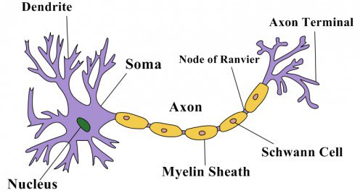

Slide 2
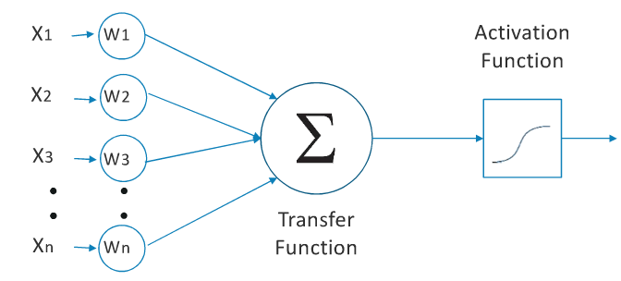

Slide 3
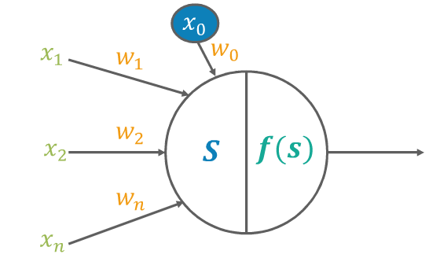

Slide 4
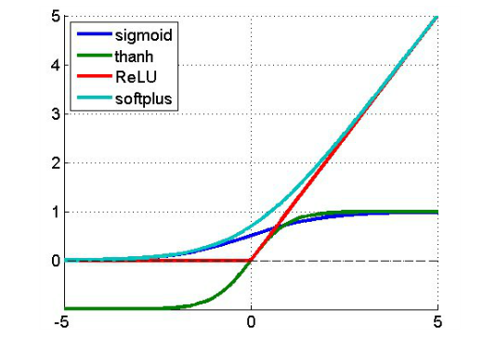
Activation Functions

Slide 5
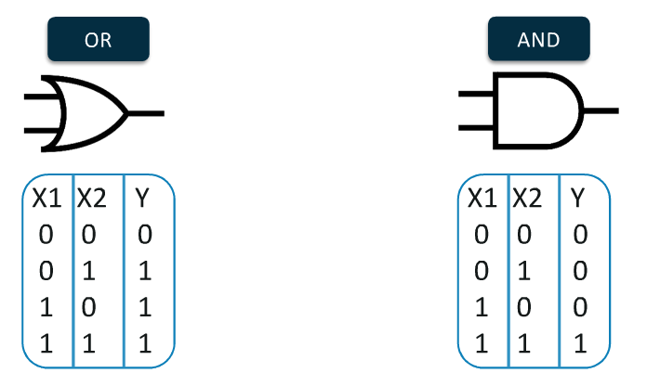
Applications of Perceptron
Simple Linear Classification
Simple Logic Gates

Slide 6
Training of a Perceptron

Slide 7
Optimization - 1

Slide 8
Optimization - 2

